Slide 1
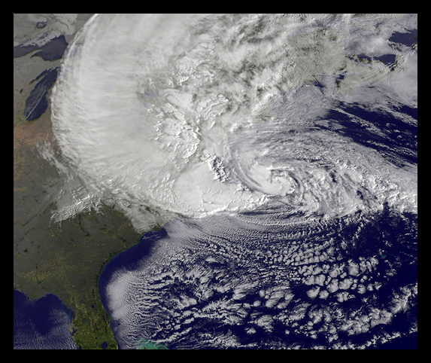

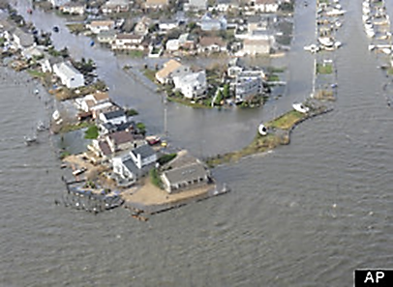
Storm Sandy
A Northeast Utilities Company
An Epic Test of Our Emergency Preparedness
William J. Quinlan
Sr. VP – Emergency Preparedness
December 21, 2012

Slide 2
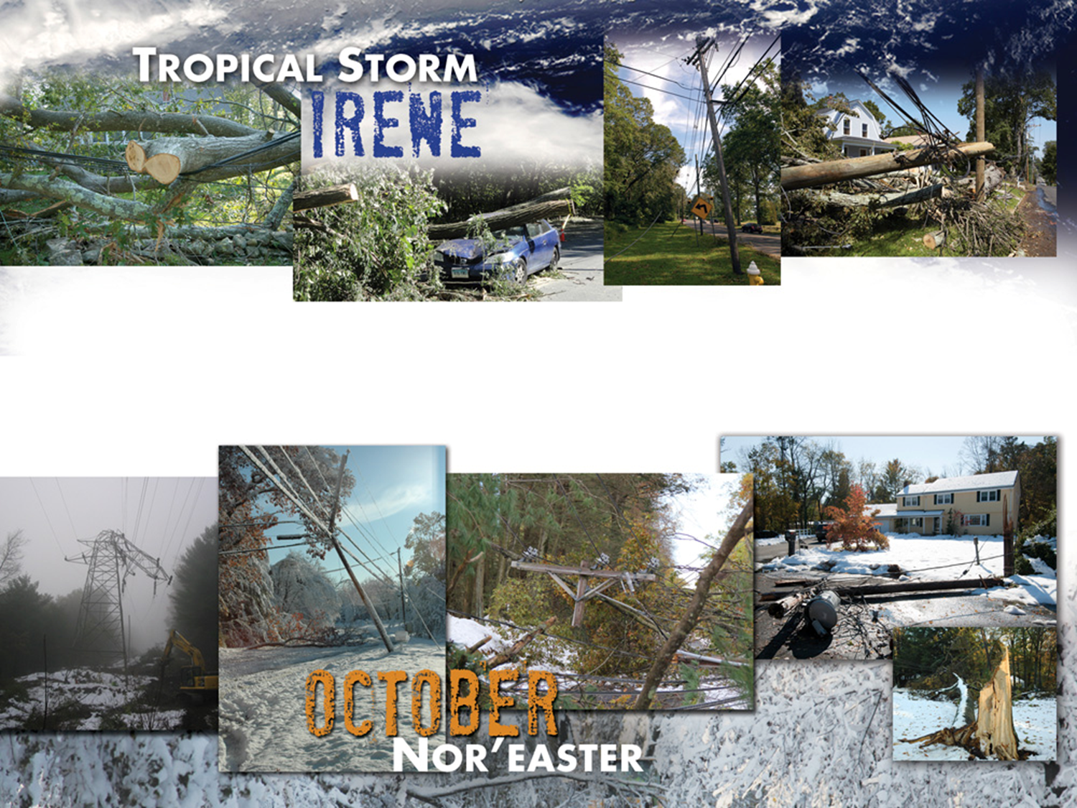
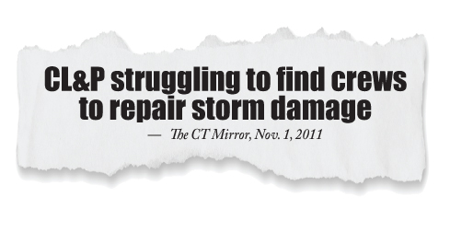
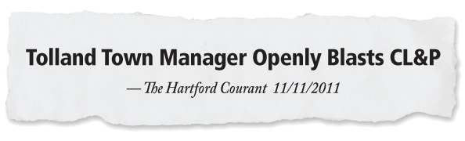
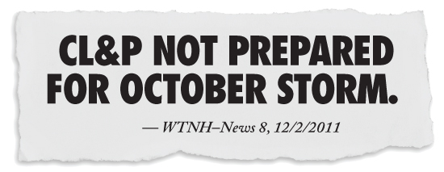
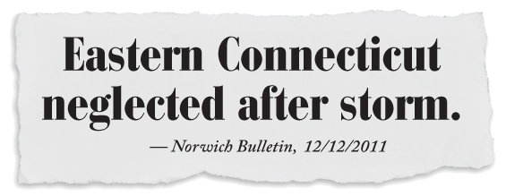
Background
The historic storms of 2011 highlighted the need to prepare for and respond to
severe weather in a way that meets rising stakeholder expectations

Slide 3
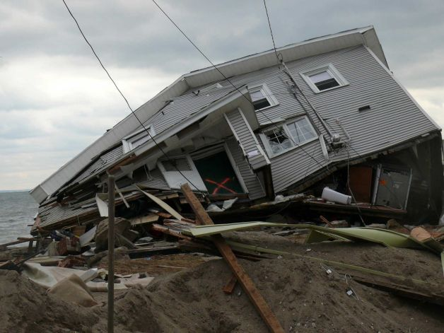
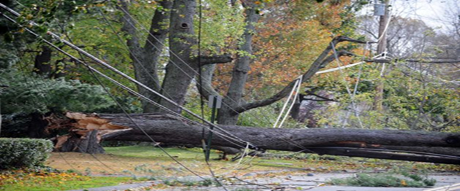
Storm Sandy Impact
President Obama declared Connecticut a major disaster area on October 30,
along with New York and New Jersey
Tri-state area took brunt of storm due to a combination of high winds and historic flooding
Sustained winds over 50 mph with peak hurricane force gusts of 85 mph
Thousands of roads blocked by fallen trees and electrical infrastructure
Unprecedented coastal flooding caused by multiple ‘full moon’ tides intensified by strong easterly winds and historic storm surge
Of the four largest power outages in CL&P’s history, three have occurred in the last 14 months

Slide 4
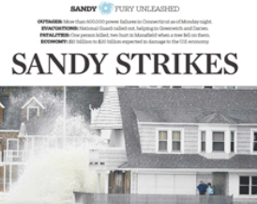

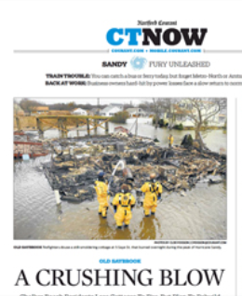
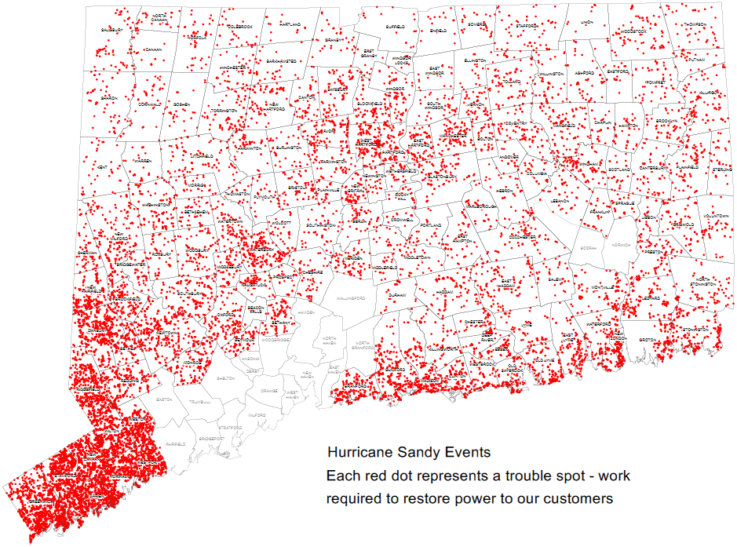

Most Recent Challenge
Sandy caused damage in every one of the 149 municipalities served by CL&P
 | Irene | Sandy
Total Customers Served | 1,239,727 | 1,239,727
Total Customers Impacted | 1,024,032 | 856,184
Trouble Spots | 16,101 | 16,460
Poles Replaced | 707 | 1,727
Transformers Replaced | 1,748 | 2,198
Conductor Replaced (ft.) | 532,296 | 557,315

Slide 5
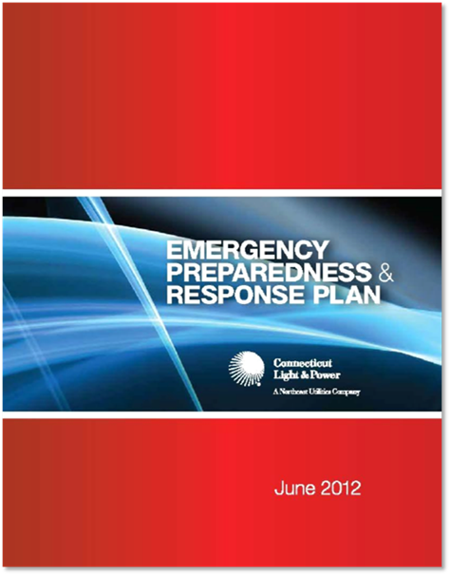
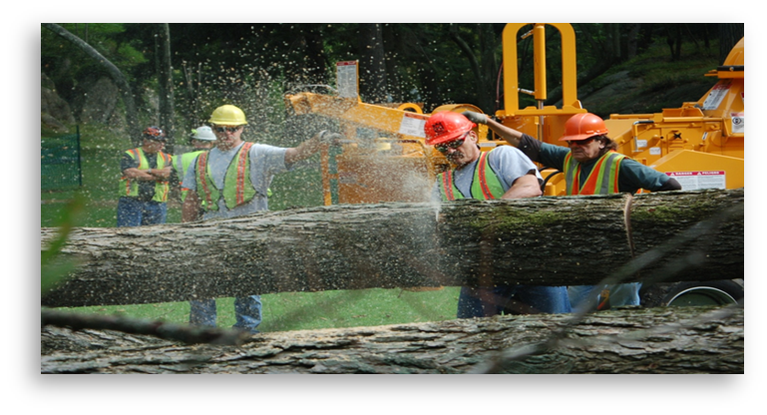
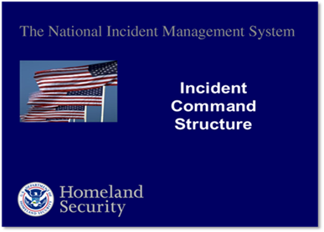
Preparedness
Due to extensive preparations, CL&P was well positioned to deliver a strong response
New emergency plan made effective June 30
Extensive training on new procedures throughout 2012
CL&P hurricane drill performed July 12
Governor’s statewide exercise conducted July 28-31
Hurricane checklist completed in advance of landfall
Secured and pre-staged critical resources

Slide 6
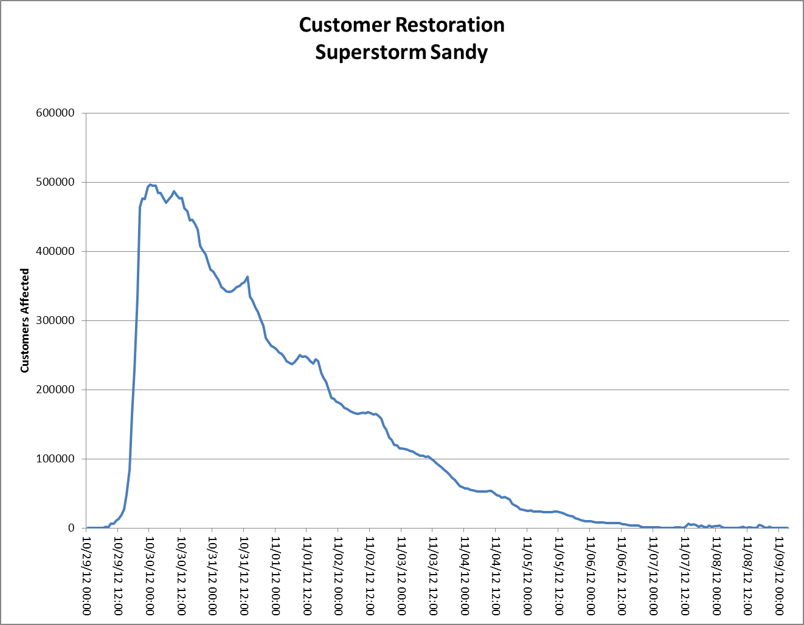
Restoration Performance
CL&P achieved all of its restoration goals
Conducted comprehensive damage assessment by Day 2
  Announced statewide restoration goal on Day 3
Achieved statewide goal for substantially completing restoration on Day 6
Peak – 496,769
10/30/2012 Midnight
Substantial Completion
Goal Achieved
Subsequent
Nor’easter

Slide 7
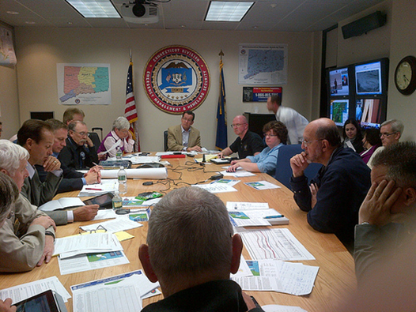
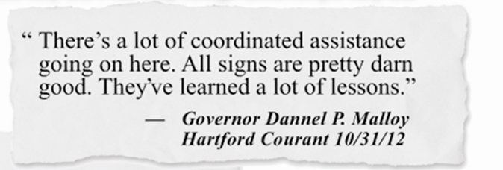
Coordination and Communications
Effective external interface with key stakeholders
Strong coordination with Governor and state agencies through multiple briefings each day:
  Unified Command meetings
  Statewide municipal conference calls
  Press conferences
  Strategic approach to media, municipal and customer relations:
    Actively told story to all audiences of preparation and massive response
    Carefully coordinated media opportunities, including press conferences, interviews and field visits
    Real time restoration updates by dedicated town liaisons
    Proactive outreach to customers and easy access to event information through self-service tools and social media

Slide 8
Emergency Preparedness Program
Storm Sandy reinforced the importance of continuous improvement program
Preparedness
Scalability
Coordination
Communications
Situational Awareness
Infrastructure Hardening
Plans, Processes & Procedures
Incident Command Structure & Staffing
Partnership with Municipalities
Restoration
Projections
Crew & Work Tracking
Vegetation Management
Training/Drills/
Exercises
Contractor Agreements
Partnership with State Agencies
Town Liaison Program
Damage Assessment
Standards Review
Storm Forecasting
Mutual Aid
Partnership with Other Utilities
Crisis Management
Electrical & Structural Hardening
Public Education
Logistics
Customer
Engagement
Selective Hardening
Post-Storm Assessment
Restoration Strategy
System Automation
Transmission
Post-Storm Forensics
Preparedness
Response / Recovery
Mitigation
7

